Slide 1
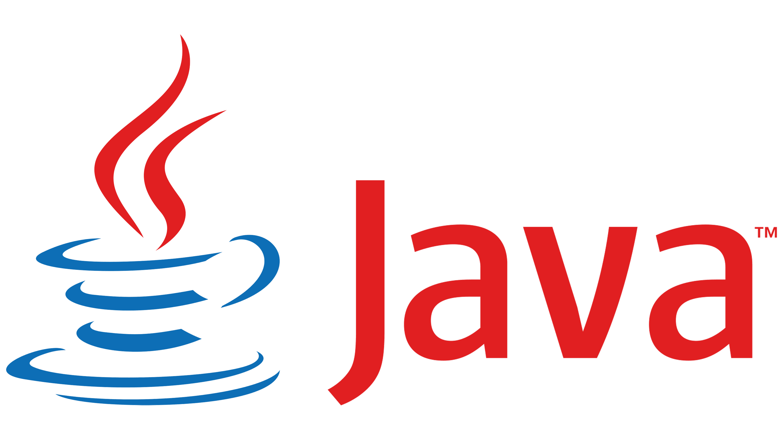
Welcome to the Java workshop

Slide 2
Java is OBJECT ORIENTED PROGRAMMING language
->In an IT we have two types of programming models (paradigms) are available. They are
procedure oriented programming language and object oriented programming language.
->If we represent the data using procedural oriented programming languages then there is no security for the data which we represent.
->For example:- when we represent the data of a student in C language using structures concept, the student data can be accessed by all the functions which we write as a part of C program. If one of the functions manipulates or damages the data then we are loosing correction-less (integrity) of the data. Examples of procedure oriented programming languages are FORTRON, COBOL, PASCAL, BASIC, C, etc.

Slide 3
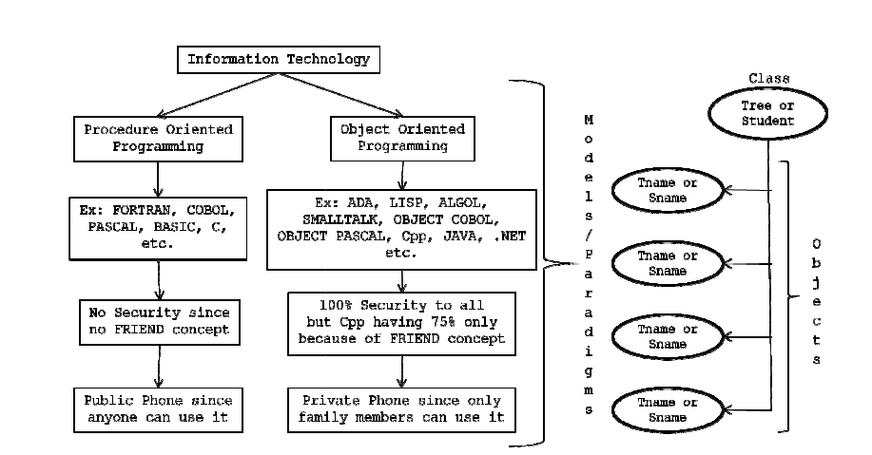

Slide 4
When we represent the data in object oriented programming language we get the security. Examples of object oriented programming languages are LISP, ADA, ALGOL, SMALLTALK, OBJECT COBOL, OBJECT PASCAL, Cpp, JAVA, DOT NET, etc. In order to say any language is an object oriented programming language it has to satisfy 8 principles of OOPs.

Slide 5
OOPs Principles:
Class.
Object.
Data Abstraction.
Data Encapsulation.
Inheritance.
Polymorphism.
Dynamic Binding.
Message Passing.

Slide 6
CLASS: “A class is a way of binding the data and associated methods in a single unit”.
Any JAVA program if we want to develop then that should be developed with respective
class only i.e., without class there is no JAVA program.
In object oriented programming’s, generally we write two types of
member methods and non-member methods.
They are:
A member method is one which is comes under the scope of the class. In JAVA we use only member methods.
Non-member methods are those which are not comes under the scope of the class. JAVA does not allow non-member methods at all.

Slide 7
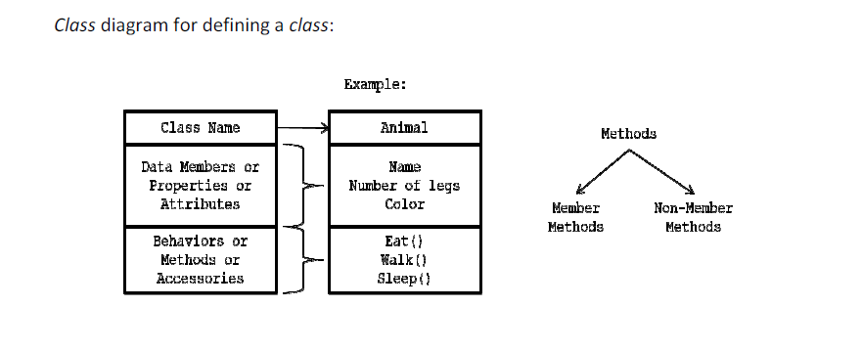

Slide 8
Syntax for defining a CLASS:
Class <clsname>
{
Variable declaration; Methods definition;
};

Slide 9
->Here, class is a keyword which is used for developing or creating user defined datatypes. Clsname r epresents a JAVA valid variable name and it is treated as name of the class. Class names are used for creating objects.
->Class contains two parts namely variable declaration and method definitions. Variable declaration represents what type of data members which we use as a part of the class. Method definition represents the type of methods which we used as the path of the class to perform an operation.
->By making use of the variables, which are declared inside the class? Every operation in JAVA must be defined with in the class only i.e., outside definition is not possible

Slide 10
Example: Define a class called a student..?
Answer:
Class student
{
Int stno;
String stname;
Float marks;
String cname;
Int getnohoursstudy ()
{
…………
…………
}
String getgrade ()
{
…………
…………
}
} [;]—optional

Slide 11
->Whenever we define a class there is no memory space for data members of the class. Memory space will be created for the data members of the class when we create object

Slide 12
NOTE:
1. In JAVA memory space for the data members will be creating on heap memory (Dynamic
memory).
2. Memory space for methods will be creating on stack memory (that too when we call the
methods).
3. All constants of any JAVA program is available in associative memory (retrieving data from
associative memory is negligible).
4. The class definition exists only one time but whose objects can exists many number of times
i.e., a class is acting as a formula form.

Slide 13
2. OBJECT: In order to store the data for the data members of the class, we must create an object.
1. Instance (instance is a mechanism of allocating sufficient amount of memory space for data members of a class) of a class is known as an object.
2. Class variable is known as an object.
3. Grouped item (grouped item is a variable which allows us to store more than one value) is known as an object.
4. Value form of a class is known as an object.
5. Blue print of a class is known as an object.
6. Logical runtime entity is known as an object.
7. Real world entities are called as objects.

Slide 14
NOTE:
• JAVA always follows dynamic memory allocation but not static memory allocation.
• In order to create a memory space in JAVA we must use an operator called new. This new operator is known as dynamic memory allocation operator.

Slide 15
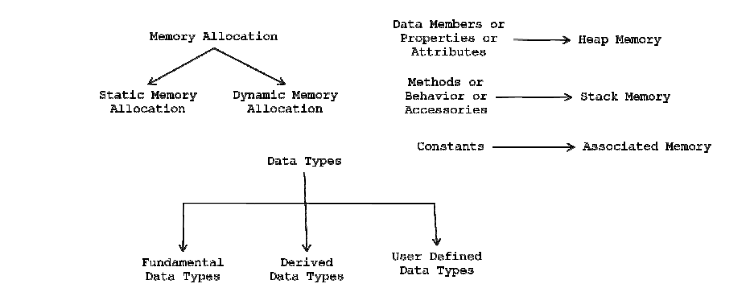

Slide 16
Syntax-2 for defining an OBJECT:
<Clsname> objname; //object declaration//
Objname = new <clsname ()>; //objectreferencing//

Slide 17
->When an object is declared where value is null. Since, there is no memory space for data members of the class. When the object is referenced the value of the object is not null. Since, memory space is created for the data members of the class.

Slide 18
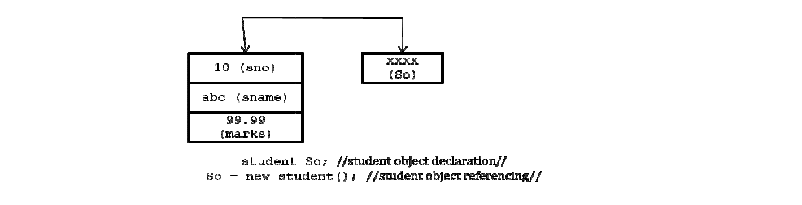

Slide 19
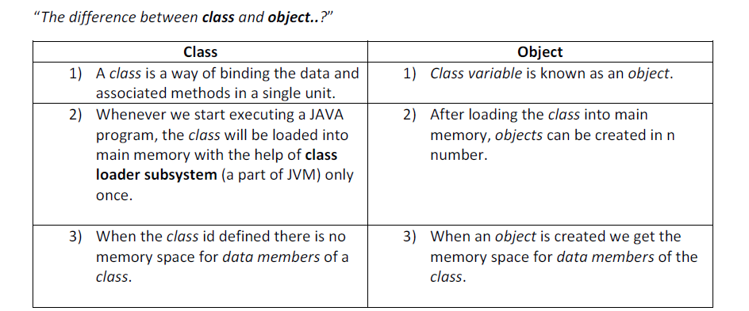

Slide 20
Data Abstraction:

Slide 21
“Data abstraction is a mechanism of retrieving the essential details without dealing with background details”.

Slide 22
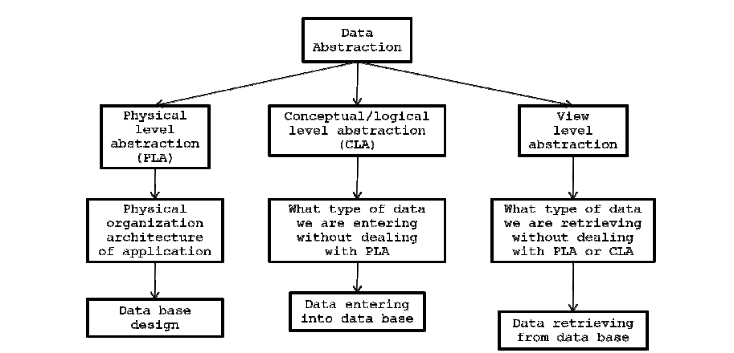

Slide 23
NOTE:

Slide 24
->In real world we have three levels of abstractions. They are physical level abstraction,conceptual/logical level abstraction and view level abstraction.
->Physical level abstraction is one; it always deals with physical organization architecture of the application. For example, in real world an application designing of any problem comes under physical level abstraction.

Slide 25


Slide 26
Conceptual/logical level abstraction is one it always deals with what kind of data we are entering without dealing with physical architecture of the application. For example, entering the data into the database, writing the coding and applying testing principle comes under conceptual level abstraction.

Slide 27
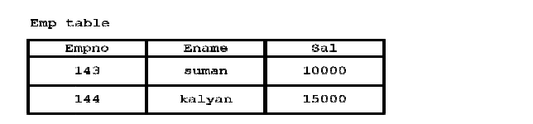

Slide 28
View level abstraction deals with what kind of data we are retrieving without dealing with both conceptual level abstraction and physical level abstraction. For example, retrieving the data from the data base in various combinations. All internet users come under view level abstraction.

Slide 29
Data Encapsulation:

Slide 30
“Data encapsulation is the process of wrapping up on data and associated methods in a
single unit”.
Data encapsulation is basically used for achieving data/information hiding i.e., security.
When we want to send the data from client to the server we must always send in the form of JAVA object only. Since, by default the JAVA object is in encrypted form (we should not send the data from client to the server in the form of fundamental data).

Slide 31
Inheritance:

Slide 32
Inheritance is the process of taking the features (data members + methods) from one class to another class.
The class which is giving the features is known as base/parent class.
The class which is taking the features is known as derived/child/sub class.
Instance is known as sub classing or derivation or extendable classes or reusability.

Slide 33
Advantages of INHERITANCE

Slide 34
->Application development time is very less.
Redundancy (repetition) of the code is reducing. Hence we can get less memory cost and consistent results.
Instrument cost towards the project is reduced. We can achieve the slogan write one’s reuse/run anywhere (WORA) of JAVA.

Slide 35
Types of INHERITANCES (Reusable techniques):

Slide 36
->Based on taking the features from base class to the derived class, in JAVA we have five types of inheritances. They are as follows:

Slide 37
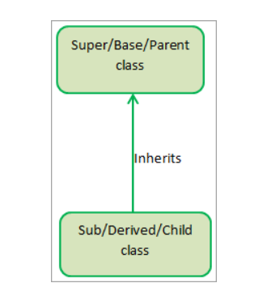
Single Inheritance:

Slide 38
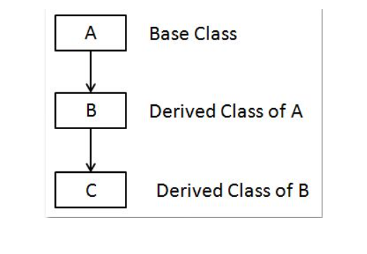
Multi Level Inheritance:

Slide 39
->Multi level inheritance is one which there exist single base class, single derived class and n number of intermediate base classes.
->An intermediate base class is one, in one context it acts as bass class and in another context
it acts as derived class.

Slide 40
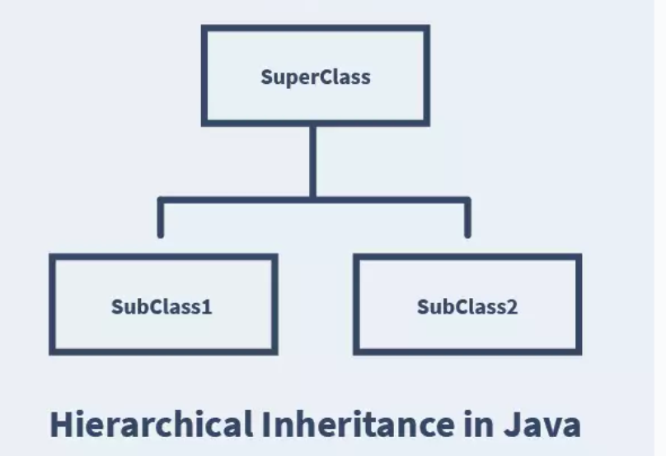
Hierarchical Inheritance:

Slide 41
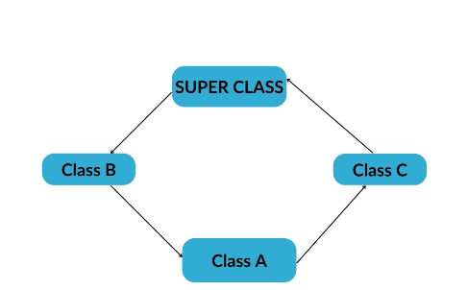
Multiple Inheritances:

Slide 42
->Multiple inheritance is one in which there exists n number of bass classes and single derived classes.
->Multiple inheritances are not supported by JAVA through classes but it is supported by JAVA through the concept of interfaces.

Slide 43
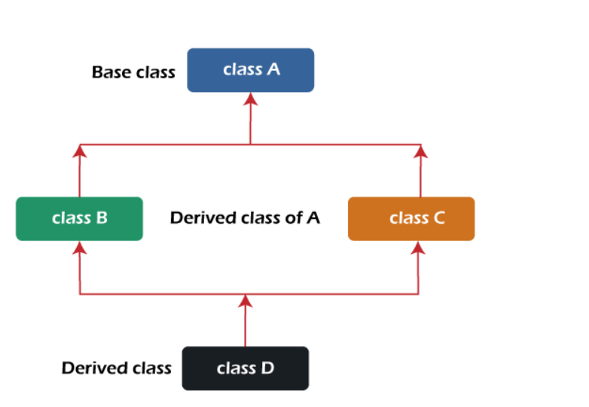
Hybrid Inheritance:

Slide 44
->In the combination, one of the combinations is multiple inheritances.
->Hybrid inheritance also will not be supported by JAVA through the concept of classes but it is supported through the concept of interfaces.

Slide 45
Polymorphism

Slide 46
Polymorphism is a process of representing “one form in many forms”.
In object oriented programming’s, we have two types of polymorphism. They are compile time polymorphism and run time polymorphism.
JAVA does not support compile time polymorphism but JAVA supports only run time polymorphism.

Slide 47
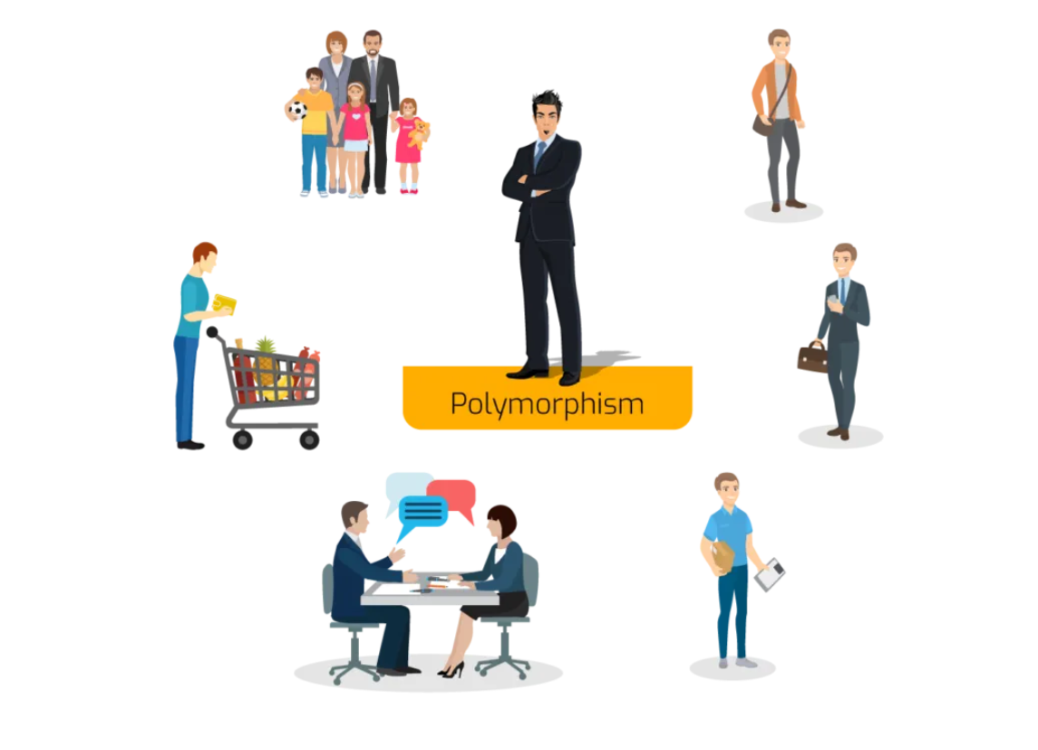

Slide 48
Dynamic Binding

Slide 49
“Dynamic binding is a mechanism of binding an appropriate version of a derived class which is inherited from base class with base class object”.

Slide 50
Every real time application will be developed with concept of polymorphism and executed with the concept of dynamic binding.
Dynamic binding is basically used to reduce the amount of memory space for improving the performance of JAVA applications.

Slide 51
NOTE:

Slide 52
Function overriding = function heading is same but function definition is different.
A function is said to be overloaded function if and only if function name is same but its signature (signature represents number of parameters, type of parameters and order of parameters) is different.

Slide 53
Message Passing:

Slide 54
Definitions:
Exchanging the data between multiple objects is known as message passing.

Slide 55
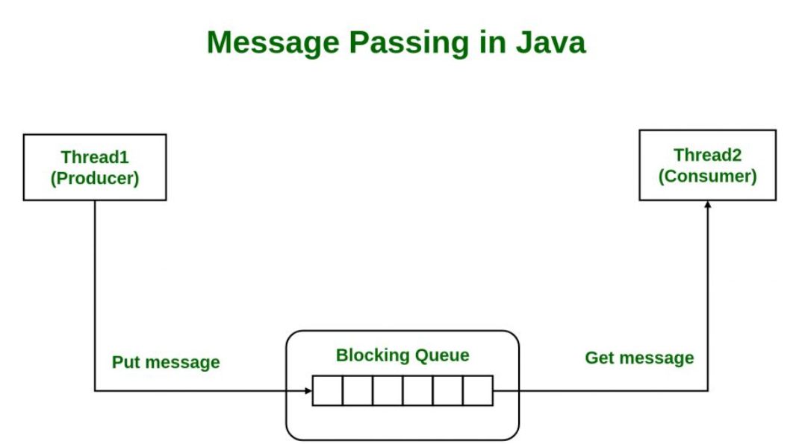

Slide 56
DATA TYPES

Slide 57
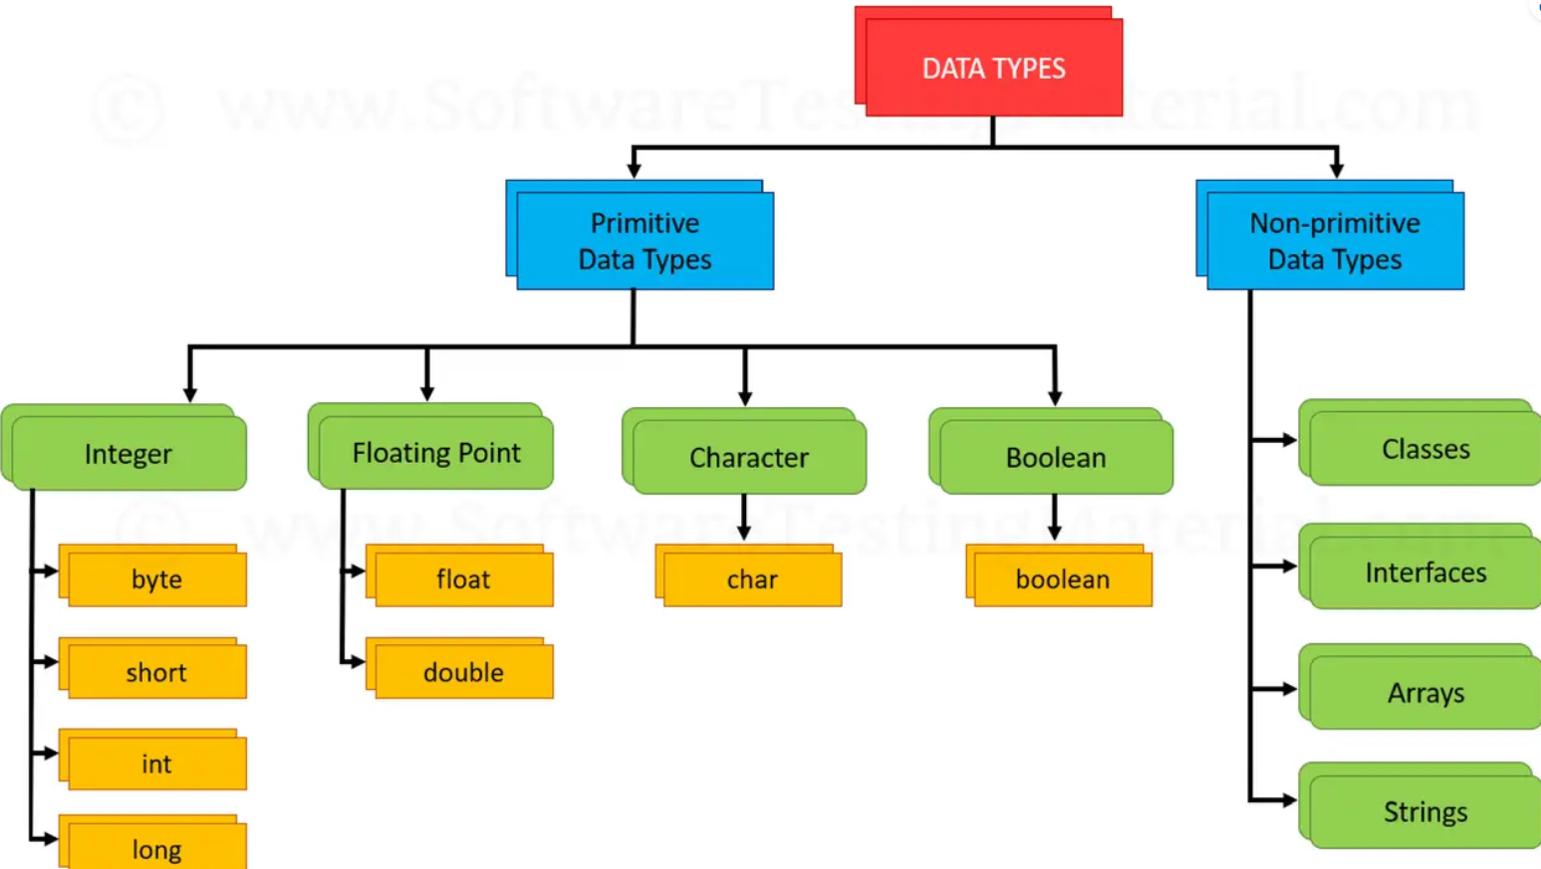

Slide 58
->In JAVA, we have eight data types which are organized in four groups. They are integer
->category data types, float category data types, character category data category data types.

Slide 59
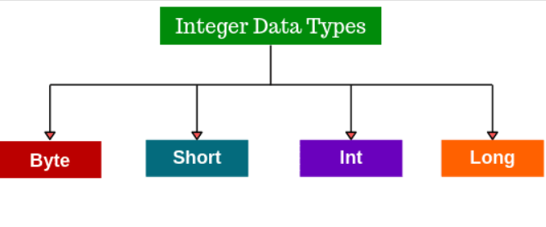
Integer category data types

Slide 60
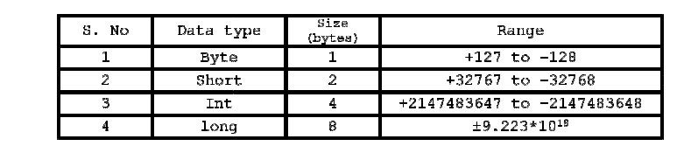

Slide 61
NOTE

Slide 62
->Range of any data type = (A) number of bits occupied by a data type
->Where, A = number of bits available in the language which is understand by computer i.e., 2 bits.

Slide 63
For example:

Slide 64
Range of byte = 2⁸
= 1 to 256
= 0 to 255
= 0 to (255/2)
= (127.5 - 0.5 = +127) (127.5 + 0.5 = -128)
Float category data types:
Float category data types are used for representing the data in the form of scale, precision i.e., these category data types are used for representing float values. This category contains two data types; they are given in the following table:

Slide 65
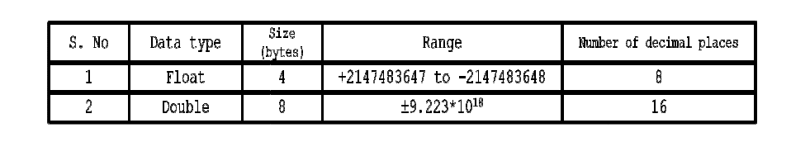

Slide 66
->Whenever we take any decimal constant directly in a JAVA program it is by default treated as highest data type in float category i.e., double.

Slide 67
Character category data types

Slide 68
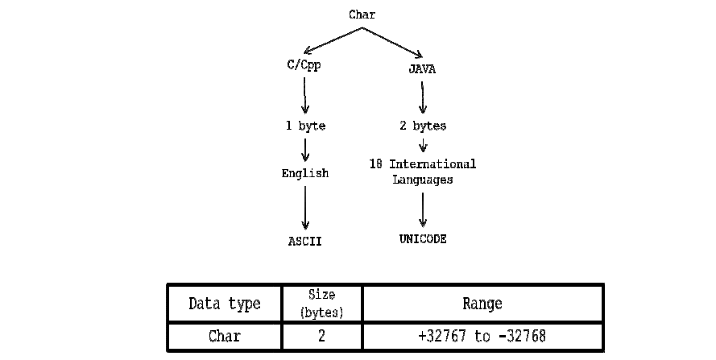

Slide 69
A character is an identifier which is enclosed within single quotes.
In JAVA to represent character data, we use a data type called char. This data type takes two bytes since it follows UNICODE character set.

Slide 70
Boolean category data types

Slide 71
Boolean category data type is used for representing logical values i.e., TRUE or FALSE
values.
To represent logical values we use a keyword called Boolean.
This data type takes 0 bytes of memory space.

Slide 72
JAVA is available in 18 international languages and it is following UNICODE character set.
UNICODE character set is one which contains all the characters which are available in 18 international languages and it contains 65536 characters.

Slide 73
NOTE:

Slide 74
All keywords in JAVA must be written in small letters only.

Slide 75
VARIABLES

Slide 76
“A variable is an identifier whose value will be changed during execution of the program”.

Slide 77
Rules for writing variables:

Slide 78
->First letter must be an alphabet. ->The length of the variable should not exceed more than 32 characters. ->No special symbols are allowed except underscore. ->No keywords should use as variable names

Slide 79
Types of variables

Slide 80
Whenever we develop any JAVA program that will be developed with respect to class only.
In a class we can use ‘n’ number of data members and ‘n’ number of methods.
Generally in JAVA, we can use two types of data members or variables. They are
instance/non-static variables and static variables.

Slide 81
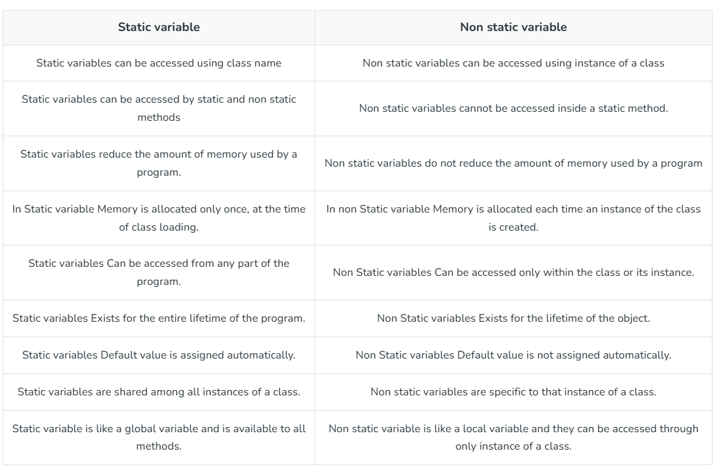

Slide 82
CONSTANTS

Slide 83
“Constant is an identifier whose value cannot be changed during execution of the program”.

Slide 84
In JAVA to make the identifiers are as constants, we use a keyword called final.
Final is a keyword which is playing an important role in three levels. They are at variable level, at method level and at class level.

Slide 85
When we don’t want to change the value of the variable, then that variable must be declared as final.

Slide 86
Syntax for FINAL VARIABLE INITIALIZATION:
Final data type v1=val1, v2=val2 … vn=valn;
For example:
Final int a=10;
a=a+20;//invalid
a=30; //invalid
When the final variable is initialized, no more modifications or assignments are possible.

Slide 87
Syntax for FINAL VARIABLE DECLARATION:
Final data type v1, v2………vn;

Slide 88
For example:
Final int a;
a=a+1; //invalid a=30+2; //invalid
a=400; //valid for 1st time a=500; //invalid

Slide 89
Whenever a final variable is declared first time assignment is possible and no more modification and further assignments are not possible. Hence, final variables cannot be modified

Slide 90
PROGRAMMIG BASIC’S

Slide 91
System.out.println (“”);
This statement is used for displaying the data or messages on to the consol (monitor).
Here, println is the predefined instance method of print stream class.
To call this method we require an object called print stream class.
The object of print stream class is called out is created as a static data member in system class (system is a predefined class).
Hence to call the println method we must use the following statement:
System.out.println (“WELCOME TO JAVA”);

Slide 92
Print stream class is a predefined class which contains nine overloaded instance println methods and nine overloaded instance print methods and whose prototypes are as follows: Public void println (byte);
Public void println (short); Public void println (int); Public void println (long); Public void println (float); Public void println (double); Public void println (char);

Slide 93
Public void println (Boolean);
Public void println (string);
Public void print (byte);
Public void print (short);
Public void print (int);
Public void print (long);
Public void print (float);
Public void print (double);
Public void print (char);
Public void print (Boolean);
Public void print (string);

Slide 94
For example 1:
Int a=40000;
System.out.println (a); //40000
System.out.println (“value of a=” + a); //value of a=40000 System.out.println (a + “is the value of a”); //40000 is the value of a

Slide 95
For example 2:
Int a=10, b=20, c; C = a + b;
System.out.println (c); //30 System.out.println (“sum=” + c); //sum=30
System.out.println (c + “is the sum”); // 30 is the sum
System.out.println (“sum of” + a + “and” + b + “=” + c); //sum of 10 and 20 is 30

Slide 96
For example 3:
System.out.println (“WELCOME TO JAVA”);

Slide 97
STRUCUTURE of a java program

Slide 98
Package details:
class <clsname>
{
Data member’s declaration; User defined methods;
Public static void main (string k [])
{
Block of statements ();
}
}

Slide 99
Every program in JAVA must be developed with respect to class.
Data member’s declaration represents the type of data members which we use as a part of the class.
User defined methods represents the type of methods which we use as a part of the class to perform some meaningful operation by making use of the data members of class.

Slide 100
Here main represents the name of the method where the program execution starts and void represents return type anything.of main method which indicates main method does not return
Since main method is executing only once hence it must be static method. Since main method can be called/accessed by everybody and hence it belongs to public method.
Block of statements represents the valid executable statements of JAVA which will call the user defined methods.

Slide 101


Slide 102


Slide 103
Vijay

